Slide 1
Right Triangles and Trigonometry
Geometry
Chapter 9

Slide 2
This Slideshow was developed to accompany the textbook
  Big Ideas Geometry
  By Larson and Boswell
  2022 K12 (National Geographic/Cengage)
Some examples and diagrams are taken from the textbook.
Slides created by
Richard Wright, Andrews Academy
rwright@andrews.edu

Slide 3
9.1 The Pythagorean Theorem
After this lesson…
• I can list common Pythagorean triples.
• I can find missing side lengths of right triangles.
• I can classify a triangle as acute, right, or obtuse given its side lengths.

Slide 4
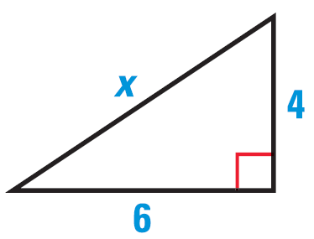
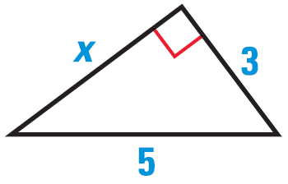
9.1 The Pythagorean Theorem
Pythagorean Theorem
In a right triangle, a² + b² = c² where a and b are the length of the legs and c is the length of the hypotenuse.
Find the value of x
Try #2
Notes:
$$3^{2}+x^{2}=5^{2}$$
$$9+x^{2}=25$$
$$x^{2}=16$$
$$x=4$$
$$6^{2}+4^{2}=x^{2}$$
$$36+16=x^{2}$$
$$52=x^{2}$$
$$x=2\sqrt{13}$$

Slide 5
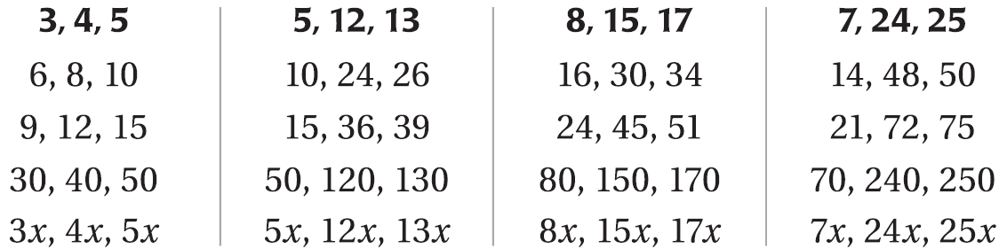
9.1 The Pythagorean Theorem
Pythagorean Triples
  A set of three positive integers that satisfy the Pythagorean Theorem

Slide 6
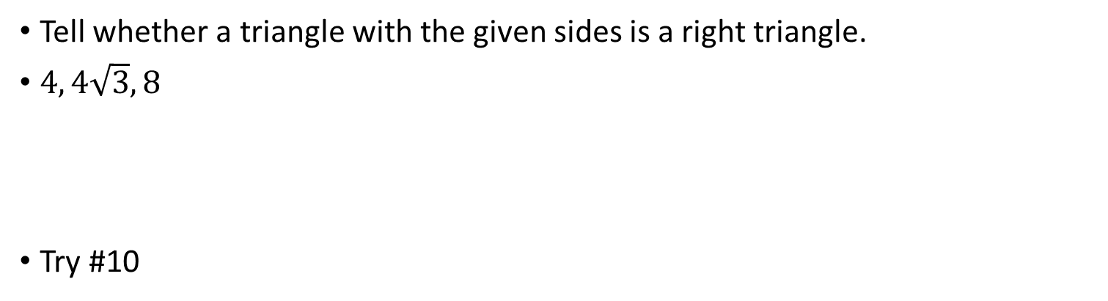
9.1 The Pythagorean Theorem
Converse of the Pythagorean Theorem
If a² + b² = c² where a and b are the length of the short sides and c is the length of the longest side, then it is a right triangle.
Tell whether a triangle with the given sides is a right triangle.
$4, 4\sqrt{3}, 8$
Try #10
Notes:
$$4^{2}+{\left(4\sqrt{3}\right)}^{2}=8^{2}$$
$$16+\left(16\right)\left(3\right)=64$$
$$16+48=64$$
$$64=64$$
Yes

Slide 7
9.1 The Pythagorean Theorem
If c is the longest side and…
c² < a² + b² → acute triangle
c² = a² + b² → right triangle
c² > a² + b² → obtuse triangle
Show that the segments with lengths 3, 4, and 6 can form a triangle
Classify the triangle as acute, right or obtuse.
Try #16
Notes:
$$3+4>6$$
$$7>6$$
$$3^{2}+4^{2} \underline{?} 6^{2}$$
$$9+16 \underline{?} 36$$
$$25<36$$
obtuse

Slide 8
9.2 Special Right Triangles
After this lesson…
• I can find side lengths in 45°-45°-90° triangles.
• I can find side lengths in 30°-60°-90° triangles.
• I can use special right triangles to solve real-life problems.

Slide 9
9.2 Special Right Triangles
Some triangles have special lengths of sides, thus in life you see these triangles often such as in construction.

Slide 10


9.2 Special Right Triangles
45°-45°-90°
30°-60°-90°
45°
60°
$$\sqrt{2}$$
1
1
2
45°
30°
1
$$\sqrt{3}$$
If you have another 45°-45°-90° or 30°-60°-90° triangle, then use the fact that they are similar and use the proportional sides.

Slide 11
9.2 Special Right Triangles
Find the value of x. Write your answer in simplest form.
Try #2
Notes:
$$\frac{x}{22}=\frac{\sqrt{2}}{1}$$
$$x=22\sqrt{2}$$
$$\frac{x}{10\sqrt{2}}=\frac{1}{\sqrt{2}}$$
$$x\sqrt{2}=10\sqrt{2}$$
$$x=10$$

Slide 12
9.2 Special Right Triangles
Find the values of x and y. Write your answers in simplest form.
Try #6
Notes:
$$\frac{x}{30}=\frac{\sqrt{3}}{2}$$
$$2x=30\sqrt{3}$$
$$x=15\sqrt{3}$$
$$\frac{y}{30}=\frac{1}{2}$$
$$2y=30$$
$$y=15$$

Slide 13
9.3 Similar Right Triangles
After this lesson…
• I can explain the Right Triangle Similarity Theorem.
• I can find the geometric mean of two numbers.
• I can find missing dimensions in right triangles.

Slide 14
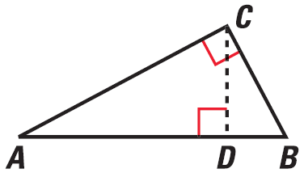
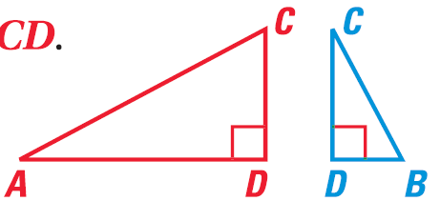
9.3 Similar Right Triangles
Right Triangle Similarity Theorem
If the altitude is drawn to the hypotenuse of a right triangle, then the two triangles formed are similar to the original triangle and to each other.
ΔCBD ~ ΔABC, ΔACD ~ ΔABC, ΔCBD ~ ΔACD

Slide 15
9.3 Similar Right Triangles
Identify the similar triangles. Then find x.
Try #4
E
E
E
H
H
H
5
5
3
3
3
x
x
x
G
G
G
G
F
F
F
4
4
4
Notes:
ΔEFG ~ ΔGFH ~ ΔEHG
$$\frac{GH}{EG}=\frac{GF}{EF}$$
$$\frac{x}{3}=\frac{4}{5}$$
$$x=\frac{12}{5}$$

Slide 16
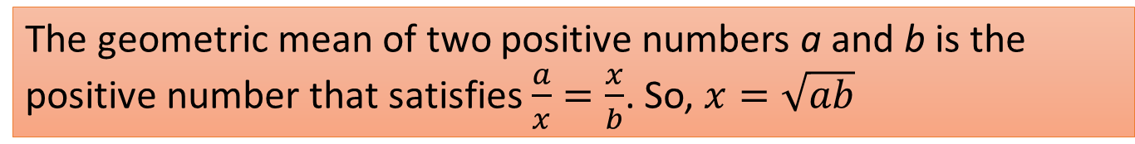
9.3 Similar Right Triangles
Geometric Mean
The geometric mean of two positive numbers a and b is the positive number that satisfies $\frac{a}{x}=\frac{x}{b}$. So, $x=\sqrt{ab}$
Find the geometric mean of 8 and 10.
Try #10
Notes:
$$\sqrt{8·10}=\sqrt{80}=4\sqrt{5}≈8.9$$

Slide 17
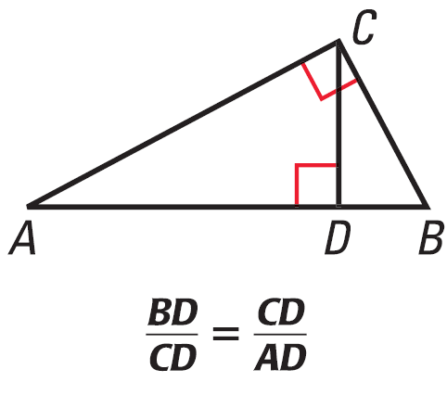
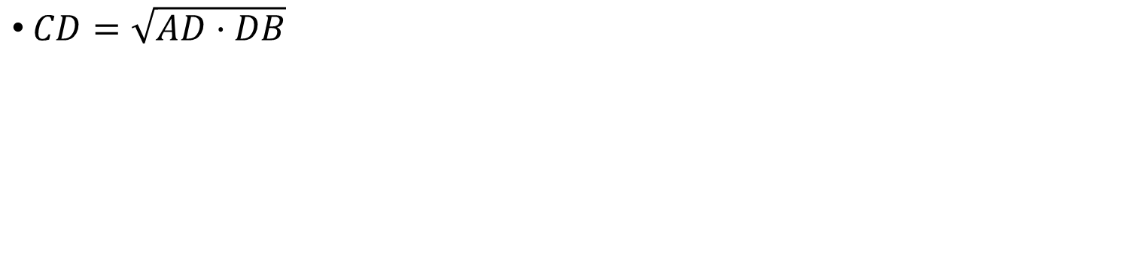
9.3 Similar Right Triangles
Geometric Mean (Altitude) Theorem
If the altitude is drawn to the hypotenuse of a right triangle, then the altitude is the geometric mean of the two segments of the hypotenuse.
$CD=\sqrt{AD·DB}$

Slide 18
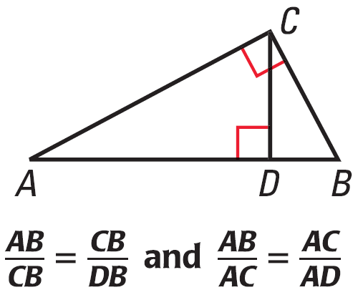
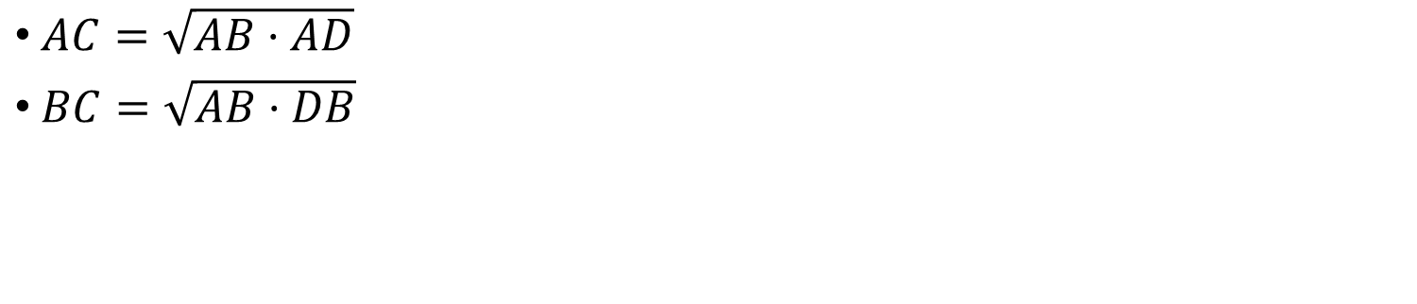
9.3 Similar Right Triangles
Geometric Mean (Leg) Theorem
If the altitude is drawn to the hypotenuse of a right triangle, then each leg is the geometric mean of the hypotenuse and the segment of the hypotenuse adjacent to that leg.
$AC=\sqrt{AB·AD}$
$BC=\sqrt{AB·DB}$

Slide 19
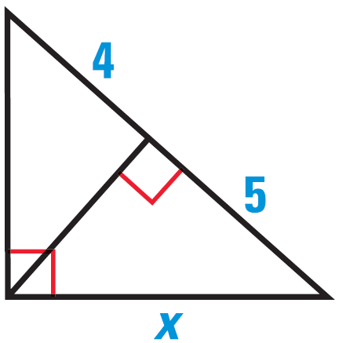
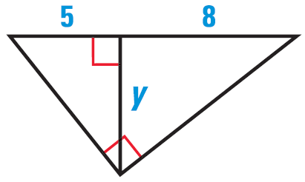
9.3 Similar Right Triangles
Find the value of x or y.
Try #18
Notes:
$$\frac{x}{9}=\frac{5}{x}$$
$$x^{2}=45$$
$$x=3\sqrt{5}=6.708$$
$$\frac{y}{5}=\frac{8}{y}$$
$$y^{2}=40$$
$$y=2\sqrt{10}=6.325$$

Slide 20
9.4 The Tangent Ratio
After this lesson…
• I can explain the tangent ratio.
• I can find tangent ratios.
• I can use tangent ratios to solve real-life problems.

Slide 21
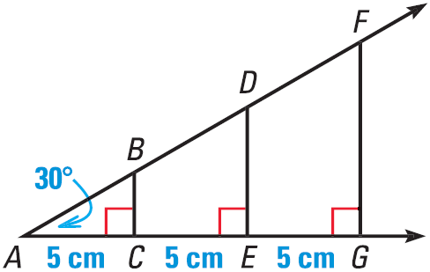
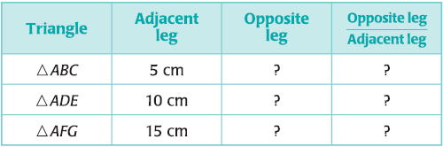

9.4 The Tangent Ratio
Draw a large 30° angle.
On one side, draw a perpendicular lines every 5 cm.
Fill in the table
Why are $\frac{BC}{DE}=\frac{AC}{AE}$ and $\frac{BC}{AC}=\frac{DE}{AE}$?
Notes:
The triangles are similar by AA similarity

Slide 22
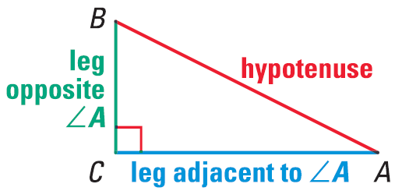

9.4 The Tangent Ratio
Tangent ratio
$\tan{A=\frac{\text{opposite} \text{leg}}{\text{adjacent} \text{leg}}}$

Slide 23
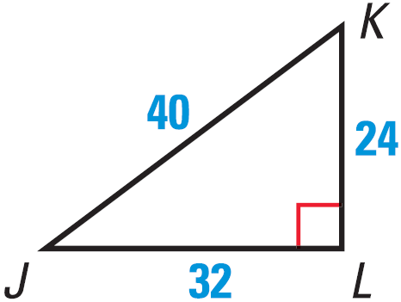
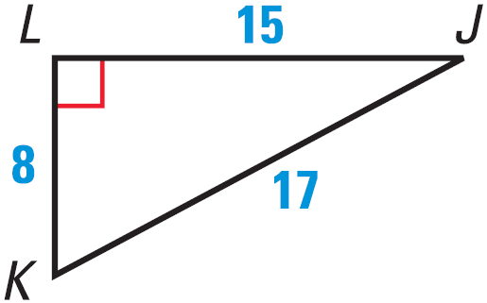
9.4 The Tangent Ratio
Find tan J and tan K.
Try #2
Notes:
$$\tan{J}=\frac{24}{32}=\frac{3}{4}$$
$$\tan{K}=\frac{32}{24}=\frac{4}{3}$$
$$\tan{J}=\frac{8}{15}$$
$$\tan{K}=\frac{15}{8}$$

Slide 24
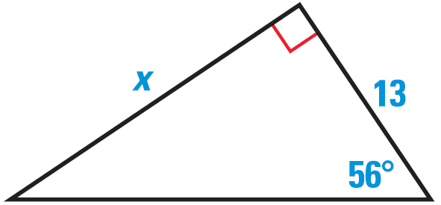
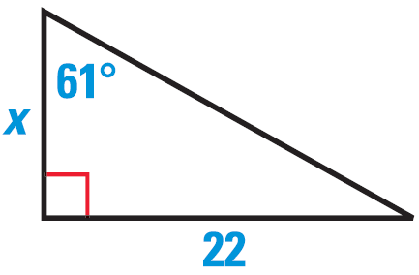
9.4 The Tangent Ratio
Find the value of x. Round to the nearest tenth.
Try #6
Notes:
$$\tan{61°}=\frac{22}{x}$$
$$x\tan{61°}=22$$
$$x=\frac{22}{\tan{61°}}=12.2$$
$$\tan{56°}=\frac{x}{13}$$
$$13 tan{56°}=x=19.3$$

Slide 25
9.5 The Sine and Cosine Ratios
After this lesson…
• I can explain the sine and cosine ratios.
• I can find sine and cosine ratios.
• I can use sine and cosine ratios to solve real-life problems.

Slide 26

9.5 The Sine and Cosine Ratios
$\sin{A}=\frac{\text{opposite} \text{leg}}{\text{hypotenuse}}$
$\cos{A}=\frac{\text{adjacent} \text{leg}}{\text{hypotenuse}}$
$\tan{A}=\frac{\text{opposite} \text{leg}}{\text{adjacent} \text{leg}}$
S O H
C A H
T O A
Notes:
SOH = Sine Opposite Hypotenuse
CAH = Cosine Adjacent Hypotenuse
TOA = Tangent Opposite Adjacent

Slide 27
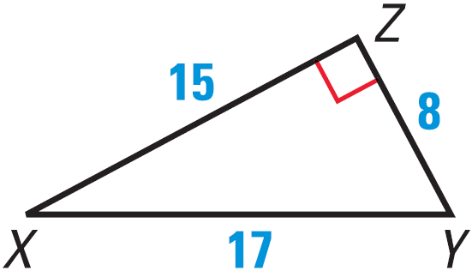
9.5 The Sine and Cosine Ratios
Find sin X, cos X, and tan X
Try #2
Notes:
$$\sin{X}=\frac{8}{17}$$
$$\cos{X}=\frac{15}{17}$$
$$\tan{X}=\frac{8}{15}$$

Slide 28

9.5 The Sine and Cosine Ratios
Sine of an angle = cosine of the complement
$\sin{A}=\cos\left(90°−A\right)=\cos{B}$
$\cos{A}=\sin{(90°−A})=\sin{B}$
Write cos 68° in terms of sine.
Try #8
Notes:
$$\cos{68°}=\sin\left(90°−68°\right)=\sin{22°}$$

Slide 29
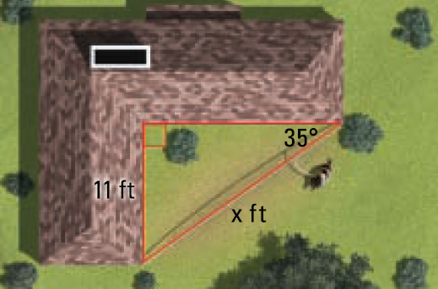
9.5 The Sine and Cosine Ratios
Find the length of the dog run (x).
Try #16
Notes:
$$\sin{35°}=\frac{11}{x}$$
$$x⋅\sin{35°}=11$$
$$x=\frac{11}{\sin{35°}}=19.2 ft$$

Slide 30
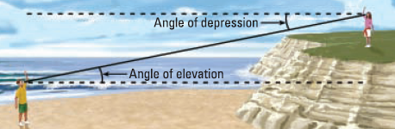
9.5 The Sine and Cosine Ratios
Angle of Elevation and Depression
  Both are measured from the horizontal
  Since they are measured to ∥ lines, they are ≅

Slide 31
9.5 The Sine and Cosine Ratios
The angle of elevation of a plane as seen from the airport is 50°. If the plane is 1000 ft away, how high is plane?
Try #28
1000 ft
x
50°
Notes:
$$\sin{50°}=\frac{x}{1000}$$
$$1000⋅\sin{50°}=x$$
$$x=766ft$$

Slide 32
9.6 Solving Right Triangles
After this lesson…
• I can explain inverse trigonometric ratios.
• I can use inverse trigonometric ratios to approximate angle measures.
• I can solve right triangles.
• I can solve real-life problems by solving right triangles.

Slide 33
9.6 Solving Right Triangles
Solve a triangle means to find all the unknown angles and sides.
  Can be done for a right triangle if you know
    2 sides
    1 side and 1 acute angle
  Use sin, cos, tan, Pythagorean Theorem, and Angle Sum Theorem

Slide 34

9.6 Solving Right Triangles
Inverse Trigonometric Ratios
  Used to find measures of angles when you know the sides.
  $\sin^{−1}{\frac{opp}{hyp}}=θ$
  $\cos^{−1}{\frac{adj}{hyp}}=θ$
  $\tan^{−1}{\frac{opp}{adj}}=θ$

Slide 35
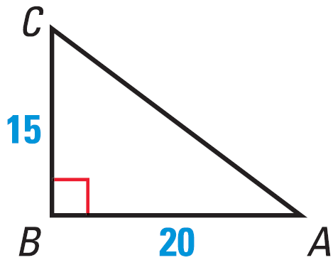

9.6 Solving Right Triangles
Find $m∠D$ to the nearest tenth if $\sin{D}=0.54$
Find $m∠C$ to the nearest tenth.
Try #6
Notes:
$$D=\sin^{−1}{0.54}=32.7$$
$$C=\tan^{−1}{\frac{20}{15}}=53.1$$

Slide 36
9.6 Solving Right Triangles
Solve a right triangle that has a 12-inch leg and a 20-inch hypotenuse.
Try #12
B
20
12
A
C
Notes:
$${12}^{2}+AC^{2}={20}^{2}$$
$$144+AC^{2}=400$$
$$AC^{2}=256$$
$$AC=16$$
$$\sin{A}=\frac{12}{20}$$
$$A=\sin^{−1}{\frac{12}{20}}=36.9°$$
$$\cos{B}=\frac{12}{20}$$
$$B=\cos^{−1}{\frac{12}{20}}=53.1°$$

Slide 37
9.7A Law of Sines
After this lesson…
• I can find areas of triangles using formulas that involve sine.
• I can solve triangles using the Law of Sines.

Slide 38
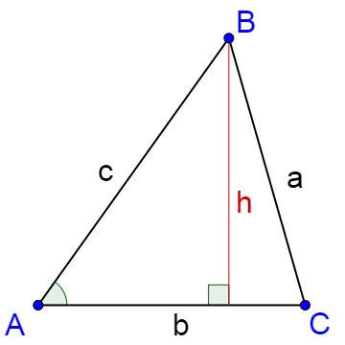
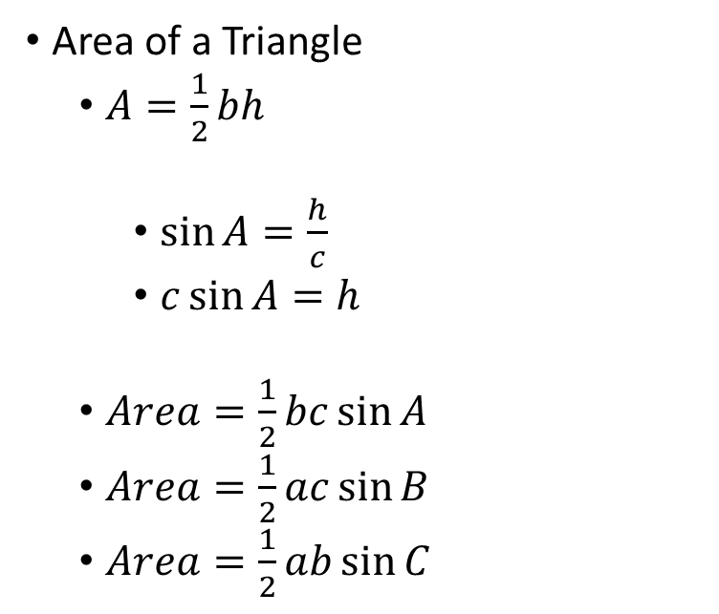
9.7A Law of Sines
Area of a Triangle
  $A=\frac{1}{2}bh$
    $\sin{A}=\frac{h}{c}$
    $c\sin{A}=h$
  $Area=\frac{1}{2}bc\sin{A}$
  $Area=\frac{1}{2}ac\sin{B}$
  $Area=\frac{1}{2}ab\sin{C}$

Slide 39
9.7A Law of Sines
Find the area of the triangle.
Try #8
Notes:
$$Area=\frac{1}{2}qs\sin{R}$$
$$Area=\frac{1}{2}\left(15\right)\left(12\right)\sin{110°}≈84.6$$

Slide 40
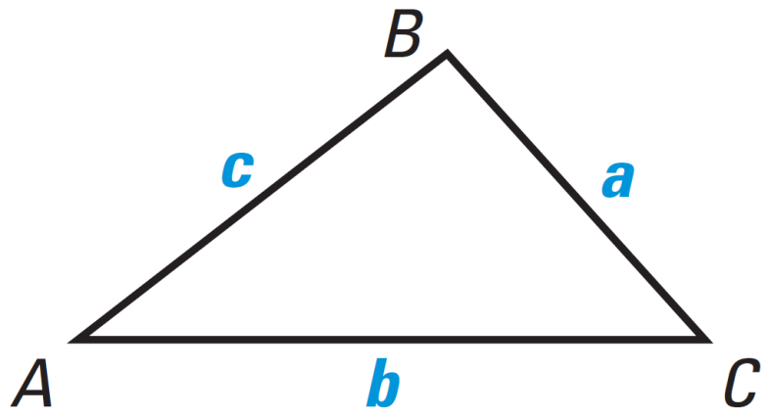
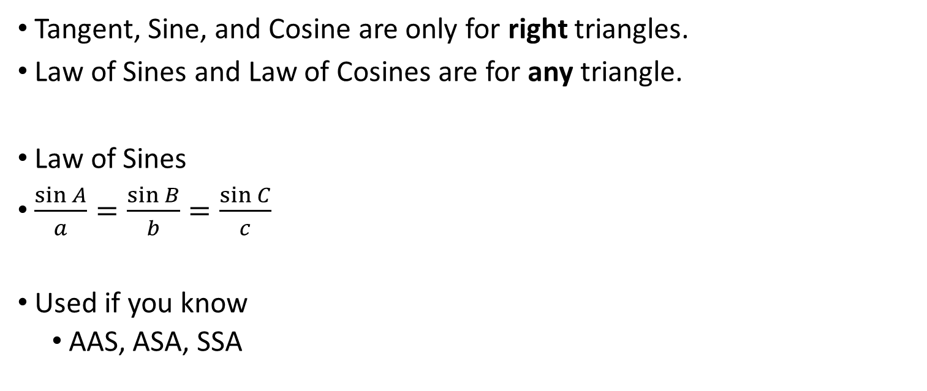
9.7A Law of Sines
Tangent, Sine, and Cosine are only for right triangles.
Law of Sines and Law of Cosines are for any triangle.
Law of Sines
$\frac{\sin{A}}{a}=\frac{\sin{B}}{b}=\frac{\sin{C}}{c}$
Used if you know
  AAS, ASA, SSA
Notes:
Only use two of the ratios at a time.

Slide 41
9.7A Law of Sines
Solve the triangle.
Notes:
$$\frac{\sin{Q}}{q}=\frac{\sin{R}}{r}$$
$$\frac{\sin{70°}}{36}=\frac{\sin{R}}{18}$$
$$36\sin{R}=18\sin{70°}$$
$$\sin{R}=0.4698$$
$$R=\sin^{−1}{0.4698}=28.0°$$
$$P=180°−70°−28.0°=82.0°$$
$$\frac{\sin{Q}}{q}=\frac{\sin{P}}{p}$$
$$\frac{\sin{70°}}{36}=\frac{\sin{82.0°}}{p}$$
$$p\sin{70°}=36\sin{82.0°}$$
$$p=37.9$$

Slide 42
9.7A Law of Sines
A surveyor makes the measurements shown to determine the length of a walking bridge to be built across a pond in a city park. Find the length of the bridge.
Try #14
Notes:
$$D=180°−65°−79°=36°$$
$$\frac{\sin{D}}{d}=\frac{\sin{F}}{f}$$
$$\frac{\sin{36°}}{45}=\frac{\sin{79°}}{f}$$
$$f\sin{36°}=45\sin{79°}$$
$$f=75.2 ft$$
$$\frac{\sin{D}}{d}=\frac{\sin{E}}{e}$$
$$\frac{\sin{36°}}{45}=\frac{\sin{65°}}{e}$$
$$e\sin{36°}=45\sin{65°}$$
$$e=69.4 ft$$

Slide 43
9.7B Law of Cosines
After this lesson…
• I can solve triangles using the Law of Cosines.

Slide 44


9.7B Law of Cosines
Law of Cosines
  $a^{2}=b^{2}+c^{2}−2bc\cos{A}$
  $b^{2}=a^{2}+c^{2}−2ac\cos{B}$
  $c^{2}=a^{2}+b^{2}−2ab\cos{C}$
Use when you know
  SSS, SAS

Slide 45
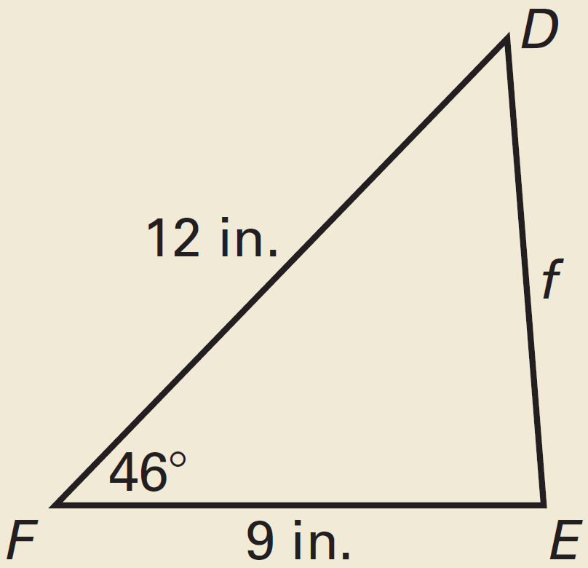
9.7B Law of Cosines
Solve the triangle.
Notes:
$$f^{2}=d^{2}+e^{2}−2de\cos{F}$$
$$f^{2}=9^{2}+{12}^{2}−2⋅9⋅12⋅\cos{46°}$$
$$f^{2}=74.9538$$
$$f=8.66 in$$
$$d^{2}=e^{2}+f^{2}−2ef\cos{D}$$
$$9^{2}={12}^{2}+{8.66}^{2}−2\left(12\right)\left(8.66\right)\cos{D}$$
$$81=144+74.9538−207.84\cos{D}$$
$$−137.9538=−207.84\cos{D}$$
$$0.66375=\cos{D}$$
$$D=\cos^{−1}{0.66375}≈48.4°$$
$$E=180°−46°−48.4°=85.6°$$

Slide 46
9.7B Law of Cosines
Solve the triangle.
Try #22
Notes:
$$a^{2}=b^{2}+c^{2}−2bc\cos{A}$$
$${30}^{2}={27}^{2}+{18}^{2}−2\left(27\right)\left(18\right)\cos{A}$$
$$900=729+324−972\cos{A}$$
$$−153=−972\cos{A}$$
$$0.1574=\cos{A}$$
$$A=\cos^{−1}{0.1574}≈80.9°$$
$$b^{2}=a^{2}+c^{2}−2ac\cos{B}$$
$${27}^{2}={30}^{2}+{18}^{2}−2\left(30\right)\left(18\right)\cos{B}$$
$$729=900+324−1080\cos{B}$$
$$−495=−1080\cos{B}$$
$$0.4583=\cos{B}$$
$$B=\cos^{−1}{0.4583}≈62.7°$$
$$C=180°−80.9°−62.7°=36.4°$$

